Slide 1
GraphTrials: Visual Proofs of Graph Properties
Henry Förster, Felix Klesen, Tim Dwyer, Peter Eades, Seok-Hee Hong, Stephen G. Kobourov, Giuseppe Liotta, Kazuo Misue, Fabrizio Montecchiani, Alexander Pastukhov, Falk Schreiber

Slide 2
Dagstuhl 23051: Perception in Network Visualization
How can a visualization unimpeachably convince an observer that a certain property is present?

Slide 3
GD Supreme Court Agenda for 18th of September
I. Elect a new judge and defense lawyer
II. three Cases to trial

Slide 4
Case 1
A communication network contains a switch whose failure would disconnect it.

Slide 5
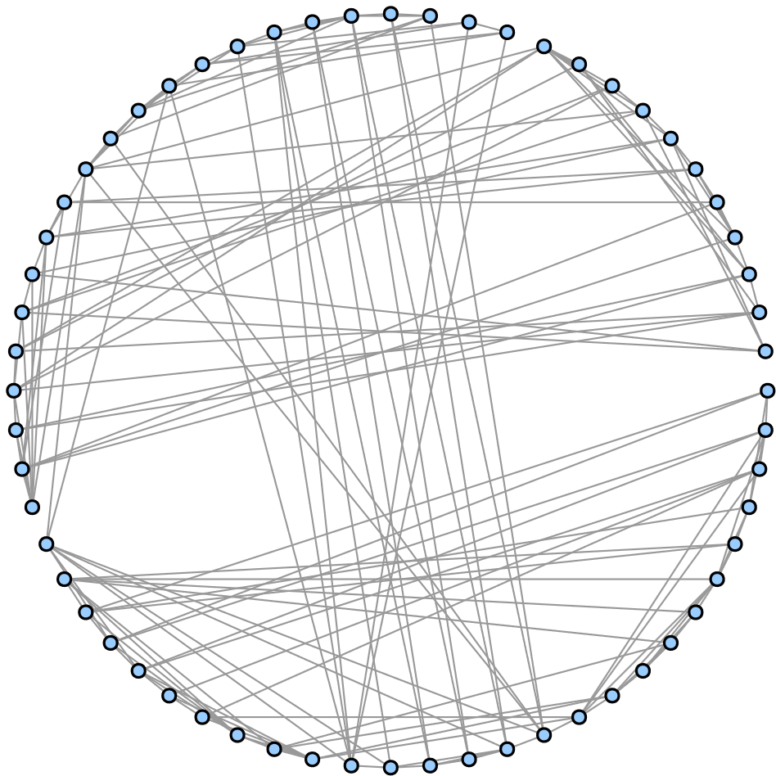
Evidence 1.A

Slide 6
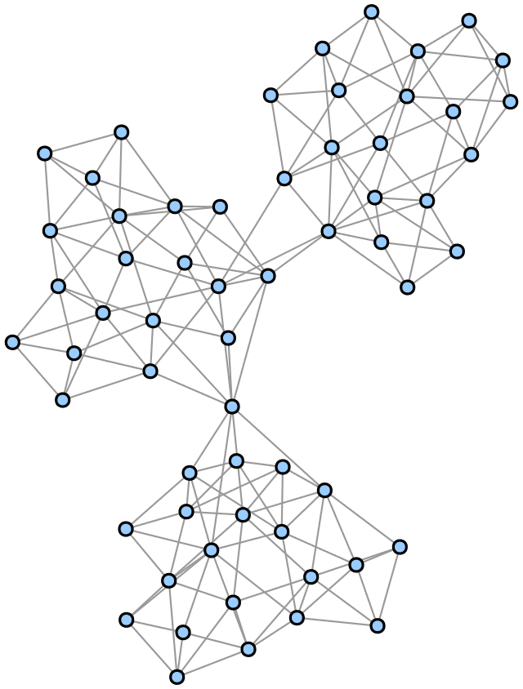
Evidence 1.b

Slide 7
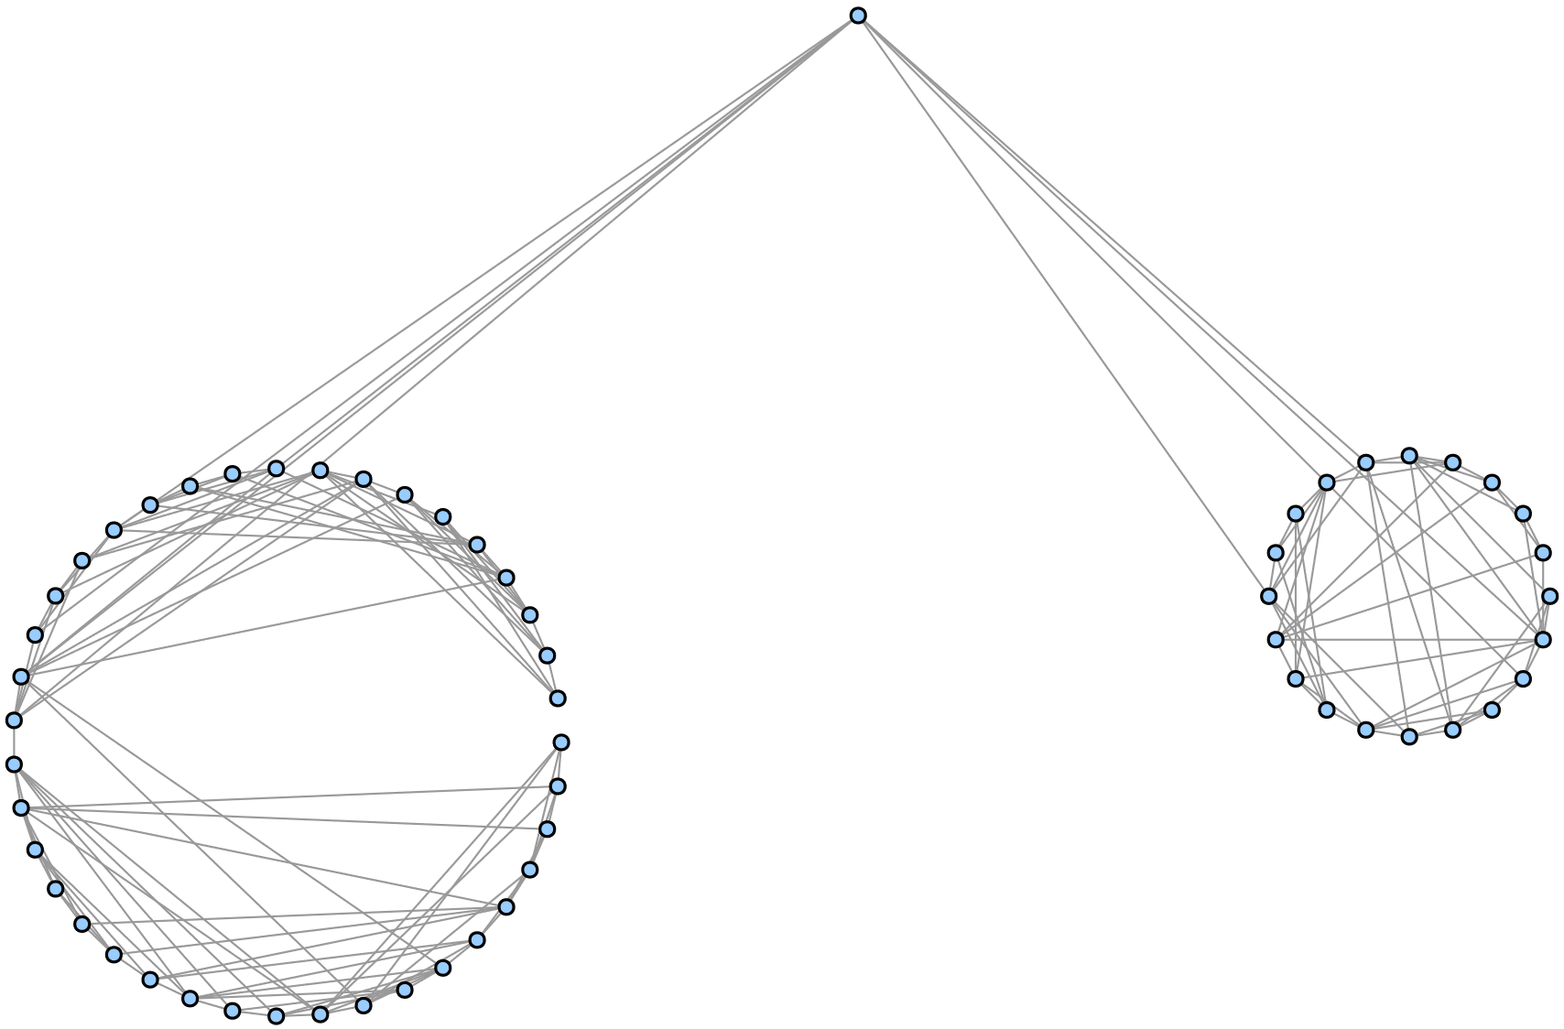
Evidence 1.C

Slide 8
Case 2
The Social Network induced by suspects in a money laundering case is connected.

Slide 9
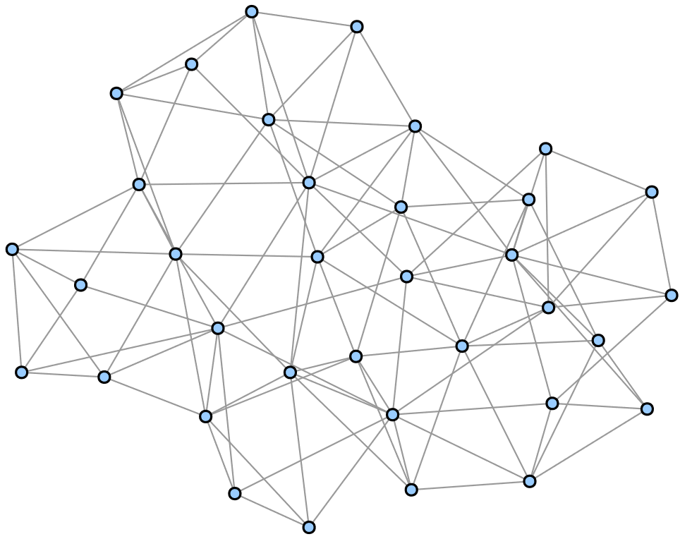
Evidence 2.A

Slide 10
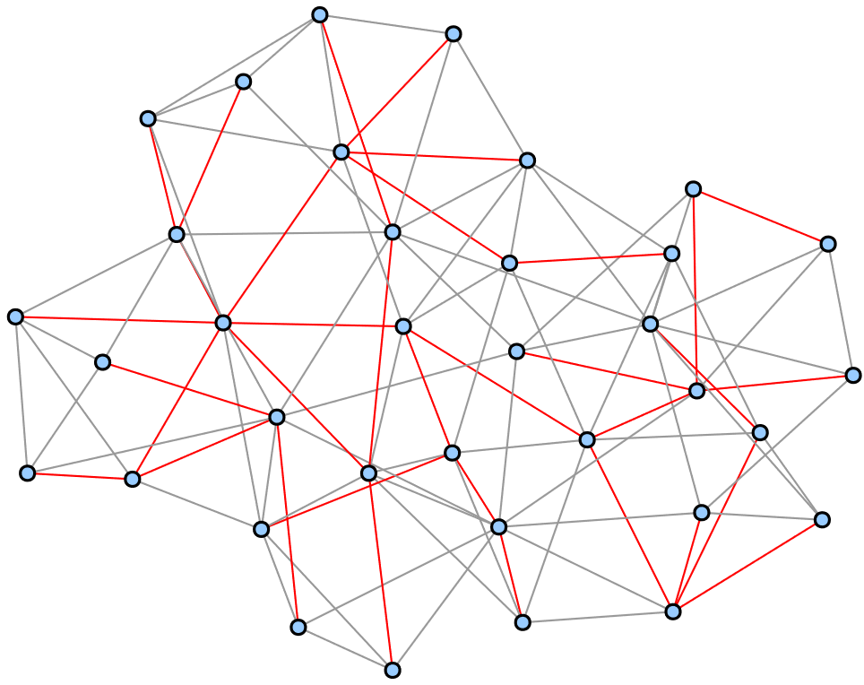
Evidence 2.B

Slide 11
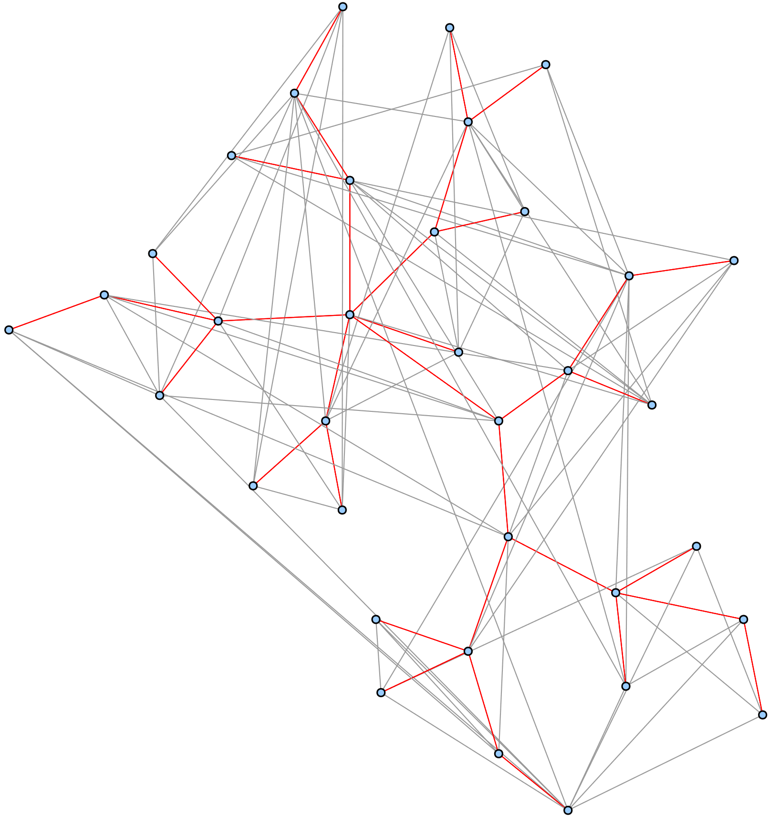
Evidence 2.C

Slide 12
Case 3
A Logistics network was classified as Hamiltonian by an ai based heuristic.

Slide 13
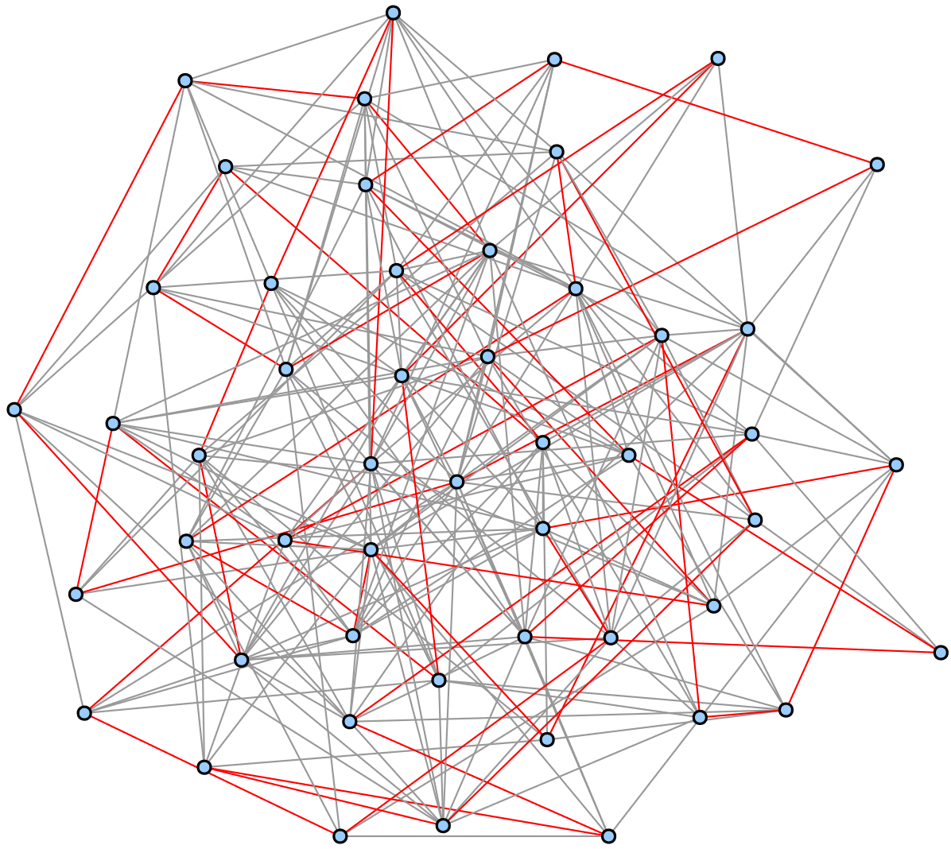
Evidence 3.A

Slide 14
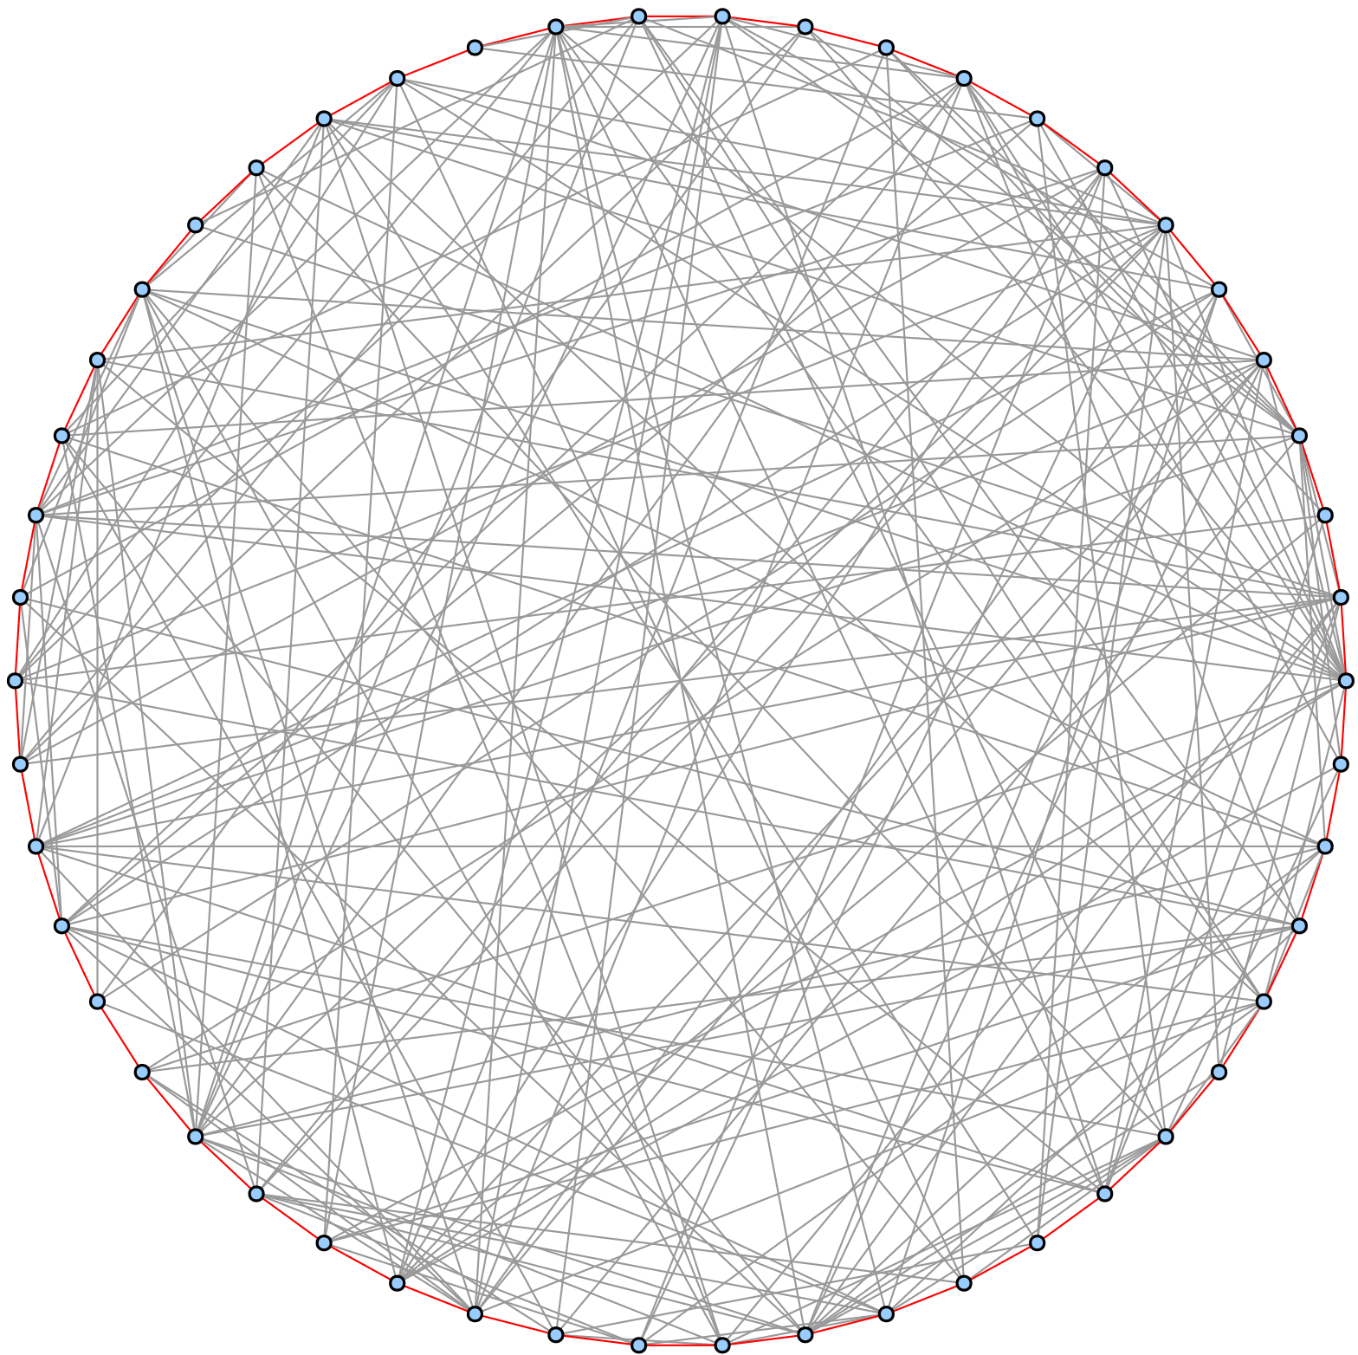
Evidence 3.B

Slide 15
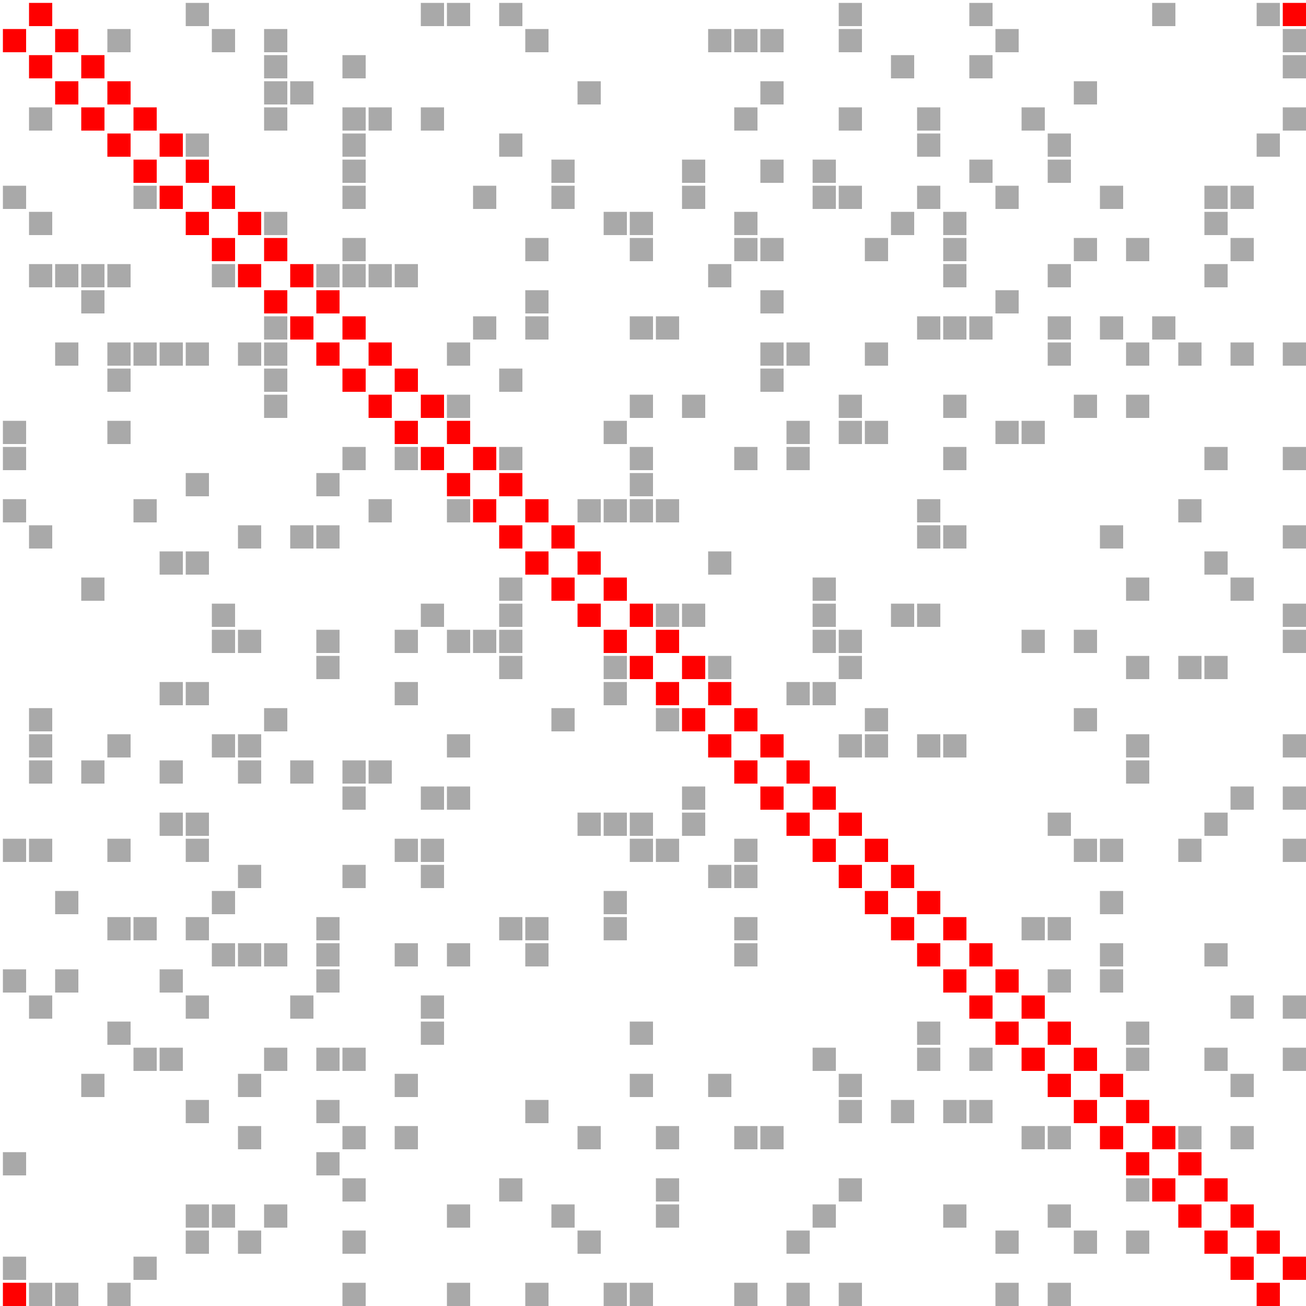
Evidence 3.C

Slide 16
Applause for the Volunteers

Slide 17
Discussion
Which effects did we observe in action?

Slide 18
Case 1: There is a Cut-Vertex
1.A: Gestalt principle of Grouping suggests one component
Missing edges on circle may create bias to wrong partition
1.B: Is there a hidden edge?
1.C: Cut-Vertex is preattentively visible
But overall readability is bad!

Slide 19
Case 2: The Graph is Connected
2.A & 2.B: Same layout
Color-highlight spanning tree to focus pre-attentive perception
Visual Query: Is it a single tree?
2.C: Improve drawing of spanning tree at cost of overall readability
Automatic grouping via similarity
Guidance for attention spread

Slide 20
Case 3: There is a Hamiltonian Cycle
3.A: High-level attention required for visual queries as in 2.B
3.B: Good cerfiticate for the instance!
Potential issue: Scalability
3.C: Different drawing paradigma
Better scaling: figure-ground separation via connectedness and similarity, corners stand out
Measure required workload of the observer to evaluate correctness

Slide 21
The GraphTrials Model
What is the process of visually proving a graph property?

Slide 22
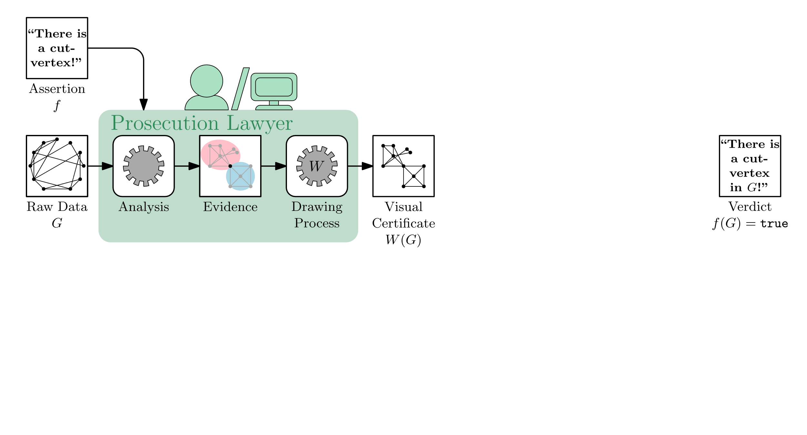
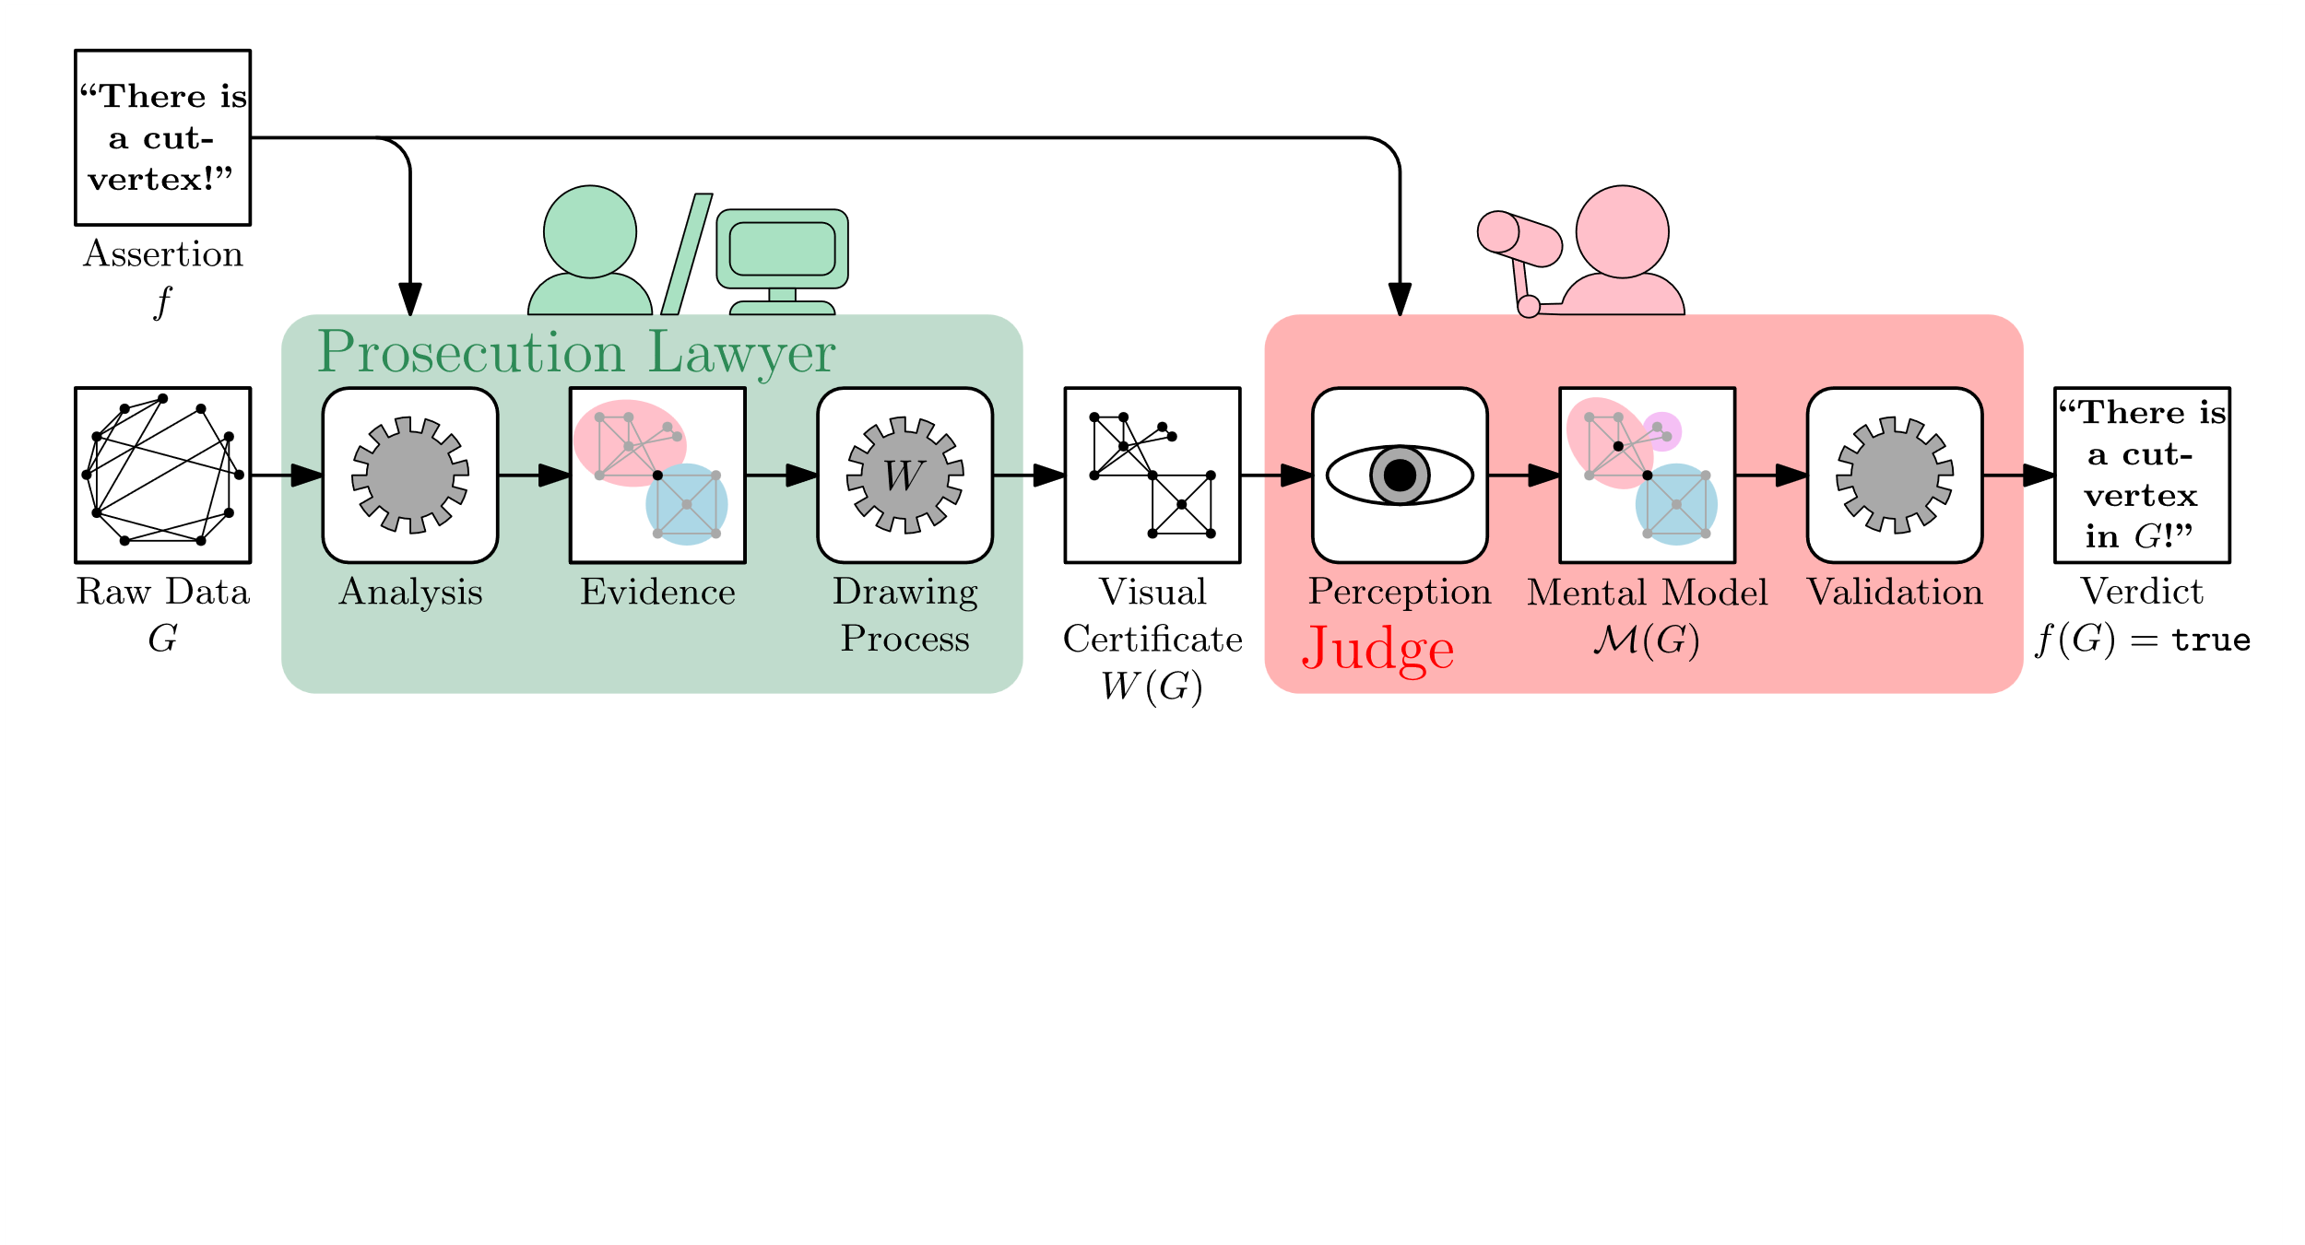
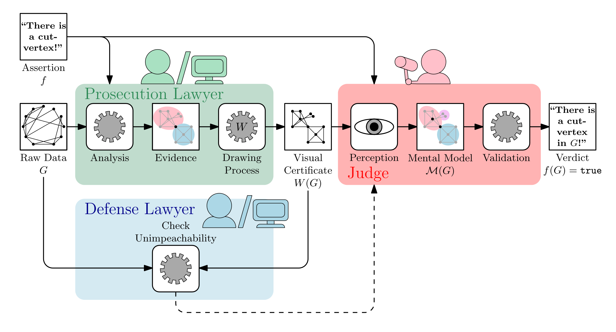
The GraphTrials

Slide 23
The Prosecution Lawyer
Task: Compute visual certificate
Analyze raw data to reveal evidence
Embed the evidence in a readable fashion into certificate drawing
Note: Extraction of evidence not in scope of the model
We may efficiently visually prove computationally hard problems!
Ideally, the visualization process can encode any valid evidence

Slide 24
The Judge
Task: Validate the assertion based on the visual certificate
Necessarily human audience
Ideally, an abstracted mental model can be used
Important: Formation of the Mental Model
Visual certificate must guide the judge‘s perception!
E.g.: Suitable topology, prominent salient features, draw attention via color

Slide 25
The Defense Lawyer
Task: Check Unimpeachability of the Certificate
Could be software, a different antagonistic person or even the lawyer
Ideally, will not have the opportunity to provide feedback to the judge
Examples: Possible Raised Concerns
Does the visualization show the input graph?
Is the certificate distinguishable from a non-certificate?

Slide 26
Visual Certificates
Which properties must a visual certificate display?

Slide 27
Visual Certificates
Definition inspired by certifying algorithms [McConell et al. 2011]
Unimpeachability: The defense lawyer cannot challenge the certificate objectively
Information Faithfulness: display ground truth properties and structures
Task Readability: necessary information is perceivable
Checkability: Given the certificate, it is trivial to verify the assertion
Visualization facilitates formation of a useful mental model
The mental model allows for efficient verification
Simplicity: Based on the mental model, there is a simple formal proof
Important aspect: perceptually distinguishable from non-certificate

Slide 28
Perceptual Complexity
Quality of a visual certificate
Measurement: Number of distinct observations by the judge for validation
Judge‘s validation as deterministic algorithm: analyze using methods from complexity theory
Recall: The judge works on the mental model!

Slide 29
Limitations
What can go wrong?

Slide 30
Limitations of our Model
Scalability
Maintaining information faithfulness is expensive
Large scale networks may require user interaction, i.e. top-down processes of perception
Dynamic graphs, non-discrete evidence
Human factors
Background knowledge may be necessary
Subjective expectations may impede objective judgment
Mental model cannot be directly analyzed

Slide 31
An Invitation to Work on Visual Proofs
Graph Drawing
Display a spanning 2-connected subgraph nicely
Draw a graph so that it is perceived as a single salient feature
Network Visualization
Scale visual proofs to larger networks
Consider temporal data and geospatial data
Perception Research
Verify that response time depends on perceptual complexity
Evaluate subjective influences on unimpeachability

