Slide 1
Upward Pointset Embeddings of Planar $st$-Graphs
Carlos Alegría, Susanna Caroppo, Giordano Da Lozzo, Marco D’Elia
Giuseppe Di Battista, Fabrizio Frati, Fabrizio Grosso, Maurizio Patrignani

Slide 2
The Upward Pointset Embeddability Problem (UPSE)
Input:
An upward planar digraph $G$ with $n$vertices
A pointset $S⊂ℝ^{2}$ with $\left|S\right|=n$ and s.t. no two points share the same $y$-coordinate
Output:
An upward planar straight-line drawing that maps the vertices of $G$ to the points of $S$
1
1
1
1
1
1
1
1
1
1
1
1

Slide 3
The State of the Art
Pointset Embeddability
$NP$-complete [Cabello '06]
Polynomial-time solvable if $G$ is a planar 3-tree [Nisham et al '10] and if $G$ has fixed embedding, bounded treewidth, and bounded face size [Biedl et al. '12]
$G$ admits a PSE on all general position pointsets if and only if $G$ is outerplanar [Gritzmann et al. '91, Castañeda et al. '96]
Upward Pointset Embeddability
$NP$-complete for $st$-graphs and 2-convex pointsets [Kaufmann et al. '12]
Polynomial-time solvable for $st$-graphs on convex pointsets [Kaufmann et al. '12]
Directed trees always admit an UPSE on one-sided convex pointsets but may not admit it on convex pointsets [Binucci et al. '10]
Notes:
Inserire riferimenti

Slide 4
Our Contributions
Graph Family | Complexity
Planar $st$-graphs | $NP$-complete
Trees | $NP$-complete
UPSE testing is $NP$-hard even if $G$ consists of disjoint $st$-paths
UPSE testing is $NP$-hard even if $G$ is a directed tree consisting of directed root-to-leaf paths
UPSE can be solved in $O(n^{4k})$ time and $O(n^{3k})$ space for $st$-graphs where $k$ is the size of the largest $st$-cutset
UPSEs can be enumerated with $O(n)$ worst-case delay using $O(kn^{4k}\log{n})$ space and $O(kn^{4k}\log{n})$ setup time.
UPSE can be solved in $O(n\log{n})$ time if $G$ is composed of 2 $st$-paths and the pointset is in general position
Non-crossing monotone Hamiltonian cycles on a pointset can be enumerated with $O\left(n\right)$ worst-case delay using $O(n^{2})$ space and setup time
Graph Family | Time | Space
Planar $st$-graphs | $$O(n^{4k})$$ | $$O(n^{3k})$$
2 $st$-paths | $$O(n\log{n})$$ | $$O(n)$$
Graph Family | Delay | Setup | Space
Planar $st$-graphs | $$O(n)$$ | $$O(kn^{4k}\log{n})$$ | $$O(kn^{4k}\log{n})$$
Hamiltonian cycles | $$O(n)$$ | $$O(n^{2})$$ | $$O(n^{2})$$
Notes:
Tabella

Slide 5
Our Contributions
Graph Family | Complexity
Planar $st$-graphs | $NP$-complete
Trees | $NP$-complete
TESTING
Graph Family | Time | Space
Planar $st$-graphs | $$O(n^{4k})$$ | $$O(n^{3k})$$
2 $st$-paths | $$O(n\log{n})$$ | $$O(n)$$
ENUMERATION
Graph Family | Delay | Setup | Space
Planar $st$-graphs | $$O(n)$$ | $$O(kn^{4k}\log{n})$$ | $$O(kn^{4k}\log{n})$$
Hamiltonian cycles | $$O(n)$$ | $$O(n^{2})$$ | $$O(n^{2})$$
Notes:
Tabella

Slide 6
$NP$-hardness
Reduction from 3-PARTITION
Input: $3b$ integers $a_{1},a_{2},…a_{3b}$ with $\sum_{i=1}^{3b}{a_{i}}=bB$ and $B/4≤a_{i}≤B/2$
$a_{i}$ is represented by a red path with $a_{i}$ internal vertices
The bags are divided by $3b+1$ blue paths with $2B+1$ internal vertices
Notes:
Solo figure, tutti a_i rossi, prima solo cammini blu. Grafo, pointet e costruzione animata

Slide 7
$NP$-hardness
Reduction from 3-PARTITION
Input: $3b$ integers $a_{1},a_{2},…a_{3b}$ with $\sum_{i=1}^{3b}{a_{i}}=bB$ and $B/4≤a_{i}≤B/2$
Notes:
Solo figure, tutti a_i rossi, prima solo cammini blu. Grafo, pointet e costruzione animata

Slide 8
$NP$-hardness
Reduction from 3-PARTITION
$3b$ integers $a_{1},a_{2},…a_{3b}$ with $\sum_{i=1}^{3b}{a_{i}}=bB$ and $B/4≤a_{i}≤B/2$
Notes:
Solo figure, tutti a_i rossi, prima solo cammini blu. Grafo, pointet e costruzione animata

Slide 9
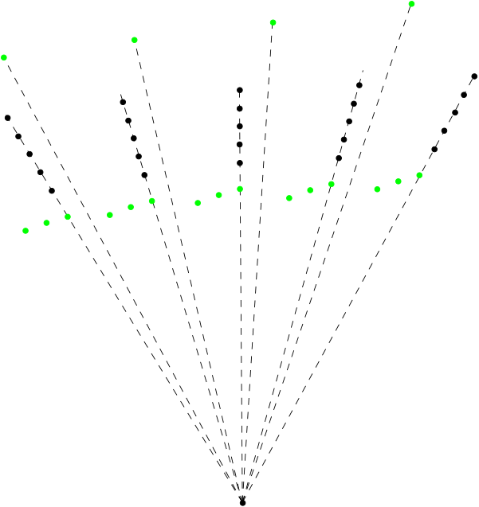
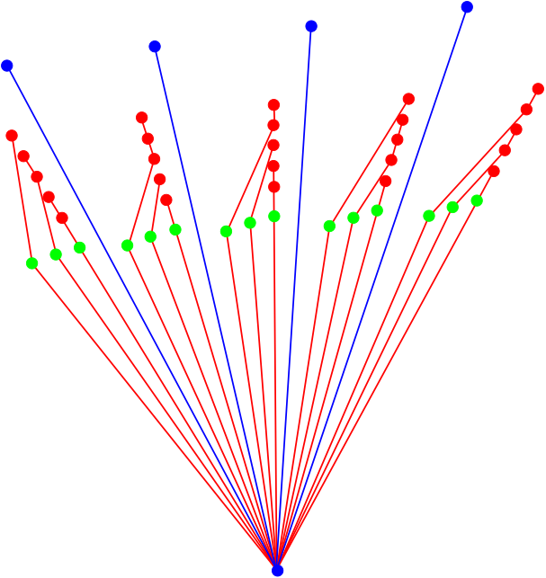
$NP$-hardness
Given a directed tree T on n vertices and a set S of n points, is it NP-hard
to decide whether T has an UPSE on S?
[Arseneva, Cano, Kleist, Mchedlidze, Mehrabi, Parada, Valtr. Upward point set embeddings of paths and trees. WALCOM ‘21]
Notes:
Open problem, disegni senza etichette

Slide 10
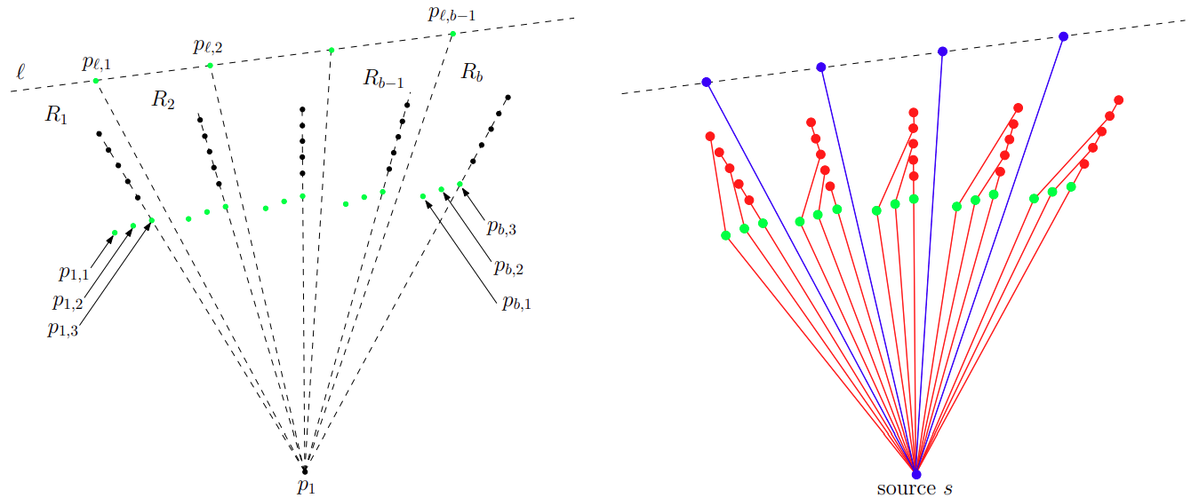
$NP$-hardness
Reduction from 3-PARTITION
Input: $3b$ integers $a_{1},a_{2},…a_{3b}$ with $\sum_{i=1}^{3b}{a_{i}}=bB$ and $B/4≤a_{i}≤B/2$
$a_{i}$ is represented by a red path with $a_{i}$ internal vertices
The buckets are divided by $3b+1$ blue paths with $2B+1$ internal vertices
Notes:
Open problem, disegni senza etichette

Slide 11
The Parameter
An $st$-cutset of $G = (V, E)$is a subset $W$ of $E$such that:
removing $W$ from $E$ results in two connected components $C_{s}$and $C_{t}$
$s$ belongs to $C_{s}$ and $t$ belongs to $C_{t}$
any edge in $W$ has its tail in $C_{s}$ and its head in $C_{t}$
$$t$$
$$C_{t}$$
1
1
1
1
1
$$k=6$$
$$W$$
1
$$C_{s}$$
$$s$$
Notes:
Allargare s e t. W in rosso e nel disegno. Centrare disegno

Slide 12
The Parameter
An $st$-cutset of $G = (V, E)$is a subset $W$ of $E$such that:
removing $W$ from $E$ results in two connected components $C_{s}$ and $C_{t}$,
$s$ belongs to $C_{s}$ and $t$ belongs to $C_{t}$, and
any edge in $W$ has its tail in $C_{s}$ and its head in $C_{t}$.
The size of the maximum $st$-cutset of $G$ is $k$
$$t$$
1
1
1
1
$$k=6$$
1
1
$$s$$
Notes:
Rifare la figura e applicare il morphing separando le due metà e colorando gli archi del taglio

Slide 13
Extensibility
Given an UPSE of $C_{s}∪W$ is it extensible to an UPSE of $G$?
1
1
1
1
1
1
$$W$$
1
1
1
1
1
$$C_{s}$$
1
1
1
1
1
1

Slide 14
Extensibility
Given an UPSE of $C_{s}∪W$ is it extensible to an UPSE of $G$?
1
1
1
1
1
1
1
1
1
1
1
1
1
1
1
1
1
1
1
1
1
1
1
1
1
1
1
1
1
1
1
1
1
1

Slide 15
Extensibility
Given an UPSE of $C_{s}∪W$ is it extensible to an UPSE of $G$?
1
1
1
1
1
1
1
1
1
1
1
1
1
1
1
1
1
1
1
1
1
1
1
1
1
1
1
1
1
1
1
1
1
1

Slide 16
Extensibility
Given an UPSE of $C_{s}∪W$ is it extensible to an UPSE of $G$?
It depends only on the drawing of $W$
1
1
1
1
1
1
1
1
1
1
1
1
1
1
1
1
1
1
1
1
1
1
1
1
1
1
1
1
1
1
1
1
1
1

Slide 17
Testing
$$t$$
1
1
1
1
$$v$$
1
1
1

Slide 18
Testing
Given $W$, compute $W$’
$$t$$
1
1
1
1
$$v$$
1
1
1

Slide 19
Testing
Given $W$, compute $W$’
$$t$$
1
1
1
1
$$v$$
1
1
1
1
1
1

Slide 20
Testing
Given $W$, compute $W$’
$$t$$
1
1
1
1
$$v$$
1
1
1
1
1
1

Slide 21
Testing
Given $W$, compute $W$’
Dynamic tables of size $O\left(n^{3k}\right)$ for testing and $O\left({kn}^{4k}\log{n}\right)$for enumerating
Take all possible
$st$-cutsets and their possible drawings
$$t$$
1
1
1
1
There exists an UPSE of $C_{s}∪W$,
in which $W$ is drawn as in figure, if and only if there exists an UPSE of $C_{s′}∪W′$ for some $W$’
$$v$$
Testing in $O\left(n^{3k}\right)$ and enumeration in $O\left(n\right)$ worst-case delay after $O\left({kn}^{4k}\log{n}\right)$ setup time
1
1
1
1
1
1

Slide 22
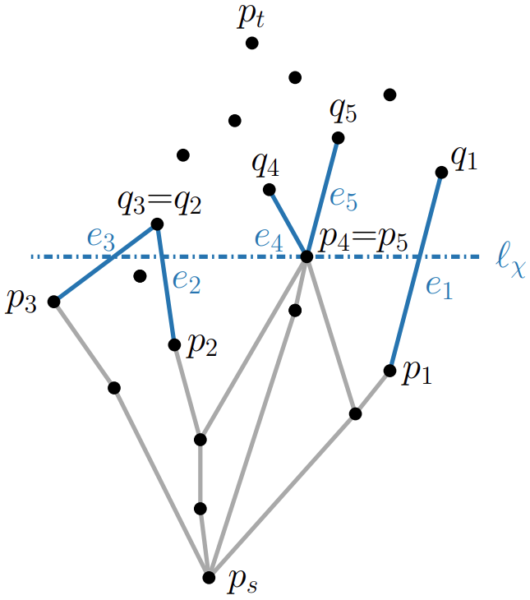
Dynamic Programming Tables
Table $T$ for testing and table $Q$ for enumerating
A key consists of $h≤k$ triplets $⟨e_{i}, p_{i}, q_{i}⟩$ for $i=1,…,h$ where $e_{i}∈E$ and $p_{i}, q_{i}∈S$ with $y\left(p_{i}\right)<y(q_{i})$
Each key $χ$ satisfies:
$E\left(χ\right)=\bigcup_{i=1}^{h}{e_{i}}$ is an $st$-cutset
$p_{i}=p_{j}$ (resp. $q_{i}=q_{j})$ if and only if $e_{i}$ and $e_{j}$ have the same tail (resp. head)
The horizontal line $ℓ_{χ}$passing through the tail with largest $y$-coordinate intersects all segments $\overline{{p_{i}q}_{i}}$, possibly at an endpoint
$T\left[χ\right]=True$ iff there exists an UPSE of $C_{s}∪E(χ)$ on a subset of $S$ containing the lowest point $p_{s}$ where the edges $E(χ)$ are drawn according to $χ$
$Q[χ]$ stores the set $Φ$ of keys such that $T\left[φ\right]=True$ and $χ$ stems from $φ$
Notes:
Definire problema che si resolve e spiegare idea algoritmo: disegni diversi con stesso disegno del cut

Slide 23
Dynamic Programming Tables
How to compute $T[χ]$ and $Q[χ]$:
If the edges in $E(χ)$ cross, then $T\left[χ\right]=False$ and $Q\left[χ\right]=∅$
Let $v_{τ}$ be the tail mapped to the point with highest $y$-coordinate by $χ$
$H^{−}⊂E(χ)$ is obtained removing from $E\left(χ\right)$ the edges having $v_{τ}$ as tail
$H^{+}$ is the set of edges having $v_{τ}$ as head
$H=H^{−}∪H^{+}$ is an $st$-cutset
Map the tails of the edges in $H^{+}$ in all possible ways to the points lower than $y\left(p_{τ}\right)$
Let $Φ^{T}$ be the set of new keys such that $T\left[φ\right]=True$
$T\left[χ\right]=True$ iff $\left|Φ^{T}\right|≥1$ and $Q\left[χ\right]=Φ^{T}$

Slide 24
An $st$-graph of all the possible UPSEs
$$n_{S}$$
Create the digraph $D$:
Each key $χ_{i}$ such that $Q\left[χ_{i}\right]≠∅$is associated with a node $n\left(χ_{i}\right)$, and there exists the edge from $n\left(χ_{i}\right)$ to $n\left(χ_{j}\right)$if $χ_{j}∈Q\left[χ_{i}\right]$
Two special nodes $n_{S}$ and $n_{T}$ are connected to all nodes $n\left(χ_{i}\right)$ such that $E\left(χ_{i}\right)$ are the edges incident to $s$ and $t$, respectively
$$n\left(χ_{k}\right)$$
$$n\left(χ_{i}\right)$$
$$n\left(χ_{j}\right)$$
$$n_{T}$$
The UPSEs of $G$ are the $n_{S}n_{T}$-paths of $D$

Slide 25
2 $st$-paths
$$t$$
$$t$$
$$P_{L}$$
$$P_{L}$$
$$P_{R}$$
$$P_{R}$$
$$ℋ_{L}$$
$$ℋ_{L}$$
$$ℋ_{L}$$
$$ℋ_{L}$$
$$s$$
$$s$$

Slide 26
2 $st$-paths
An $st$-graph consisting of 2 $st$-paths $P_{L}$ and $P_{R}$admits an UPSE on $S$ if and only if ${|P}_{L}|≥|ℋ_{L}|$ and ${|P}_{R}|≥|ℋ_{R}|$
$$t$$
$$P_{L}$$
$$P_{R}$$
$$ℋ_{L}$$
$$ℋ_{R}$$
$$s$$

Slide 27
2 $st$-paths
An $st$-graph consisting of 2 $st$-paths $P_{L}$ and $P_{R}$admits an UPSE on $S$ if and only if ${|P}_{L}|≥|ℋ_{L}|$ and ${|P}_{R}|≥|ℋ_{R}|$
$$t$$
$$t$$
$$P_{L}$$
$$P_{L}$$
$$P_{R}$$
$$P_{R}$$
$$ℋ_{L}$$
$$ℋ_{R}$$
$$s$$
$$s$$

Slide 28
2 $st$-paths
An $st$-graph consisting of 2 $st$-paths $P_{L}$ and $P_{R}$admits an UPSE on $S$ if and only if ${|P}_{L}|≥|ℋ_{L}|$ and ${|P}_{R}|≥|ℋ_{R}|$
$$t$$
$$t$$
$$P_{L}$$
$$P_{L}$$
$$P_{R}$$
$$P_{R}$$
$$ℋ_{L}$$
$$ℋ_{R}$$
$$ℋ_{L}$$
$$ℋ_{R}$$
$$s$$
$$s$$

Slide 29
2 $st$-paths
An $st$-graph consisting of 2 $st$-paths $P_{L}$ and $P_{R}$admits an UPSE on $S$ if and only if ${|P}_{L}|≥|ℋ_{L}|$ and ${|P}_{R}|≥|ℋ_{R}|$
$$t$$
$$t$$
$$t$$
$$P_{L}$$
$$P_{L}$$
$$P_{R}$$
$$P_{R}$$
$$ℋ_{L}$$
$$ℋ_{R}$$
$$ℋ_{L}$$
$$ℋ_{R}$$
$$s$$
$$s$$
$$s$$

Slide 30
2 $st$-paths
An $st$-graph consisting of 2 $st$-paths $P_{L}$ and $P_{R}$admits an UPSE on $S$ if and only if ${|P}_{L}|≥|ℋ_{L}|$ and ${|P}_{R}|≥|ℋ_{R}|$
$$t$$
$$t$$
$$t$$
$$P_{L}$$
$$P_{L}$$
$$P_{R}$$
$$P_{R}$$
$$ℋ_{L}$$
$$ℋ_{L}$$
$$ℋ_{L}$$
$$ℋ_{L}$$
$$s$$
$$s$$
$$s$$

Slide 31
Enumerating Monotone Hamiltonian Cycles
How many non-crossing Hamiltonian cycles there are on a given pointset?
Is it hard?
[Mitchell and O’Rourke 2001,
Marx and Miltzow 2016, Eppstein 2020]
We can enumerate them in single exponential time [Wettstein 2017, Yamanaka et al. 2021] or output-polynomial time [Eppstein 2023]
We can enumerate monotone non-crossing Hamiltonian cycles in worst-case linear delay!

Slide 32
Enumerating Monotone Hamiltonian Cycles
Let $S_{i}$ be the restriction of $S$ to the lowest $i$ points
A bipath on $S_{i}$ consists of two non-crossing monotone paths $L$ and $R$ sharing $s$
A bipath is extensible if and only if the grey region contains at least one point
$$ℛ$$
$$p_{i+1}$$
$$S_{i}$$
$$p_{r}=p_{i}$$
$$p_{ℓ}$$
$$L$$
$$R$$
$$s$$
Notes:
Importanza del problema. Aggiungere idea bipaths-> cycle. Disegno safeness

Slide 33
Bipath
$$t$$
$$s$$
Notes:
Importanza del problema. Aggiungere idea bipaths-> cycle. Disegno safeness

Slide 34
Bipath
$$s$$
Notes:
Importanza del problema. Aggiungere idea bipaths-> cycle. Disegno safeness

Slide 35
Bipath
$$s$$
Notes:
Importanza del problema. Aggiungere idea bipaths-> cycle. Disegno safeness

Slide 36
Bipath
$$s$$
Notes:
Importanza del problema. Aggiungere idea bipaths-> cycle. Disegno safeness

Slide 37
Bipath
$$t$$
To enumerate we try to extend each path of an extensible bipath
Check if they cross
Check if the grey region is non-empty
Those checks are done in $O(1)$ using two tables of size $O(n^{2})$
So we can enumerate with $O\left(n\right)$ worst-case delay
$$s$$
Notes:
Importanza del problema. Aggiungere idea bipaths-> cycle. Disegno safeness

Slide 38
Enumerating Monotone Hamiltonian Cycles
Let $S_{i}$ be the restriction of $S$ to the lowest $i$ points
A bipath on $S_{i}$ consists of two non-crossing monotone paths $L$ and $R$ sharing $s$
A bipath is extensible if and only if the grey region contains at least one point
$$ℛ$$
To enumerate we try to extend each path of an extensible bipath on $p_{i+1}$
Check if $\overline{{p_{ℓ}p}_{i+1}}$ crosses any bipath on $S_{i}$
Check if $ℛ$ is non-empty
These checks are done using two tables of size $O(n^{2})$
$$p_{i+1}$$
$$S_{i}$$
$$p_{r}=p_{i}$$
$$p_{ℓ}$$
$$L$$
$$R$$
$$B_{i}, X$$
$$B_{i+1}, L$$
$$B_{i+1}, R$$
$$s$$

Slide 39
Conclusions
UPSE testing is $NP$-hard even if $G$ consists of disjoint $st$-paths
UPSE testing is $NP$-hard even if $G$ is a directed tree consisting of directed root-to-leaf paths
UPSE can be solved in $O(n^{4k})$ time and $O(n^{3k})$ space for $st$-graphs where $k$ is the size of the largest $st$-cutset
UPSEs can be enumerated with $O(n)$ worst-case delay using $O(kn^{4k}\log{n})$ space and $O(kn^{4k}\log{n})$ setup time.
UPSE can be solved in $O(n\log{n})$ time if $G$ is composed of 2 $st$-paths and the pointset is in general position
Non-crossing monotone Hamiltonian cycles on a pointset can be enumerated with $O\left(n\right)$ worst-case delay using $O(n^{2})$ space and setup time

Slide 40
Conclusions
Graph Family | Complexity
Planar $st$-graphs | $NP$-complete
Trees | $NP$-complete
TESTING
Graph Family | Time | Space
Planar $st$-graphs | $$O(n^{4k})$$ | $$O(n^{3k})$$
2 $st$-paths | $$O(n\log{n})$$ | $$O(n)$$
ENUMERATION
Graph Family | Delay | Setup | Space
Planar $st$-graphs | $$O(n)$$ | $$O(kn^{4k}\log{n})$$ | $$O(kn^{4k}\log{n})$$
Hamiltonian cycles | $$O(n)$$ | $$O(n^{2})$$ | $$O(n^{2})$$

Slide 41
Open Problems
Is UPSE testing $NP$-complete if the pointset is in general position?
UPSE can be tested in polynomial time for maximal planar $st$-graphs?
It is FPT in the size of the maximum $st$-cutset or other parameters?

Slide 42
Upward Pointset Embeddings of Planar $st$-Graphs
Carlos Alegría
Susanna Caroppo
Giordano Da Lozzo
Marco D’Elia
Giuseppe Di Battista
Fabrizio Frati
Fabrizio Grosso
Maurizio Patrignani
Università degli Studi Roma Tre
Dipartimento di Ingegneria
Computer Networks Research Group

Slide 43
Upward Pointset Embeddings of Planar $st$-Graphs
Thanks for your attention
Carlos Alegría, Susanna Caroppo, Giordano Da Lozzo, Marco D’Elia
Giuseppe Di Battista, Fabrizio Frati, Fabrizio Grosso, Maurizio Patrignani

